Slide 1
Introduction/Business Problem
In a city of your choice, if someone is looking to open a restaurant, where would you recommend that they open it?

Slide 2
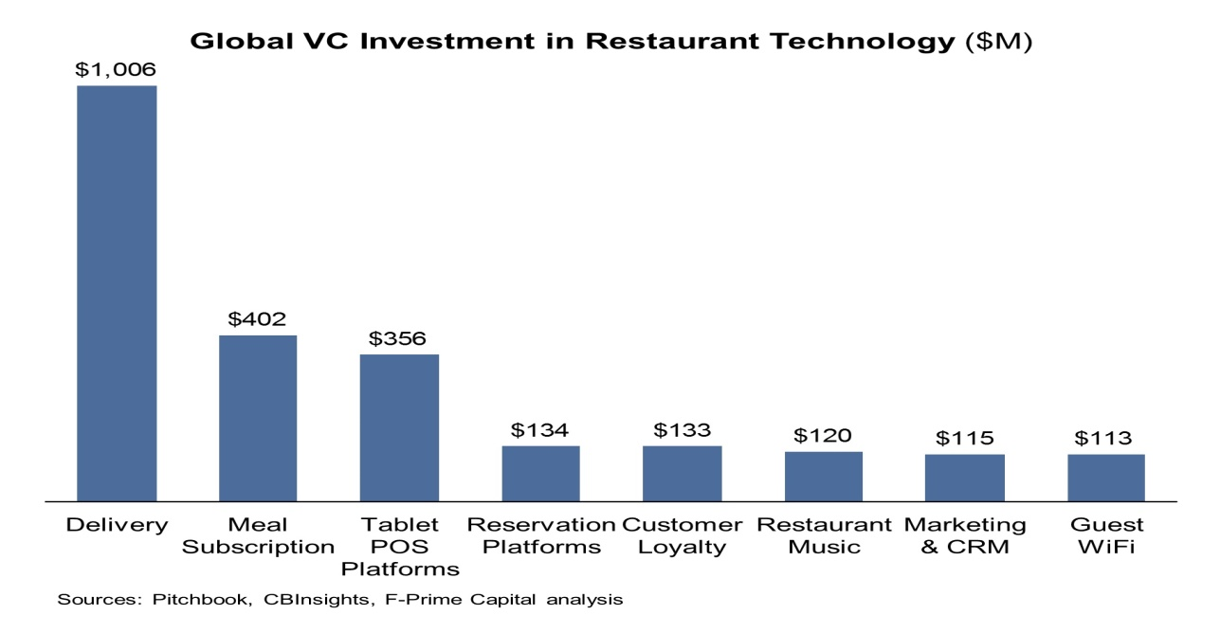
As increasing numbers of consumers want to dine out or take prepared food home, the number of food-service operations has skyrocketed from 155,000 about 40 years ago to nearly 960,000 today. But there's still room in the market for your food-service business.

Slide 3

What's Inside Introduction Business Problem Data & Restaurant Service Styles Result & Business Plan Observation Conclusion

Slide 4
Introduction
Shifting demographics and changing lifestyles are driving the surge in food-service businesses. Busy consumers don't have the time or inclination to cook. They want the flavor of fresh bread without the hassle of baking. They want tasty, nutritious meals without dishes to wash. In fact, the rise in popularity of to-go operations underscores some clear trends in the food-service industry

Slide 5

Data
With that said, who is eating at restaurants? Let's look at the main market categories of food-service business customers:
Generation Y
Generation X
Baby boomers
Empty Nesters
Seniors

Slide 6
Result
Restaurants are classified into three primary categories: quick-service, midscale and upscale.
Restaurant patrons want to be delighted with their dining experience, but they don't necessarily want to be surprised.
Armed with practical experience, you're ready to put together your business plan--the most critical element of your restaurant. Map out everything on paper before you buy the first spoon or crack the first egg.

Slide 7
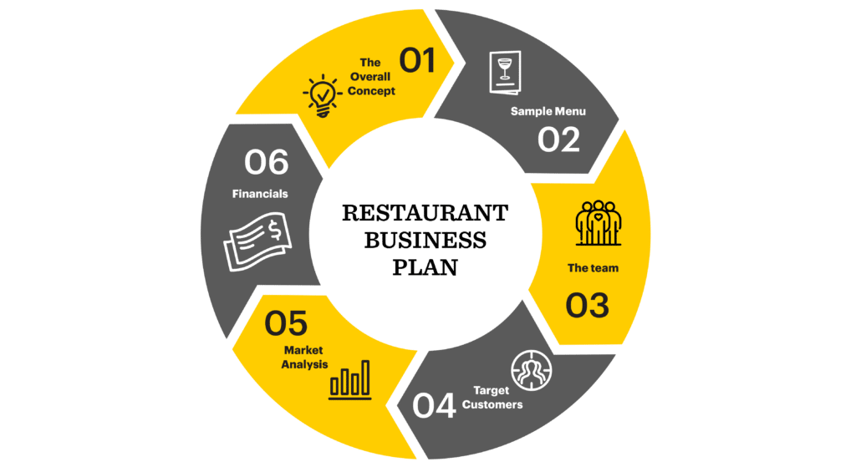

Slide 8
Observation
How much money you need to start depends on the type of business, the facility, how much equipment you need, whether you buy new or used, your inventory, marketing, and necessary operating capital (the amount of cash you need on hand to carry you until your business starts generating cash).
Layout and design are major factors in your restaurant's success. You'll need to take into account the size and layout of the dining room, kitchen space, storage space and office. Typically, restaurants allot 45 to 65 percent of their space to the dining area, approximately 35 percent to the kitchen and prep area, and the remainder to storage and office space.

Slide 9
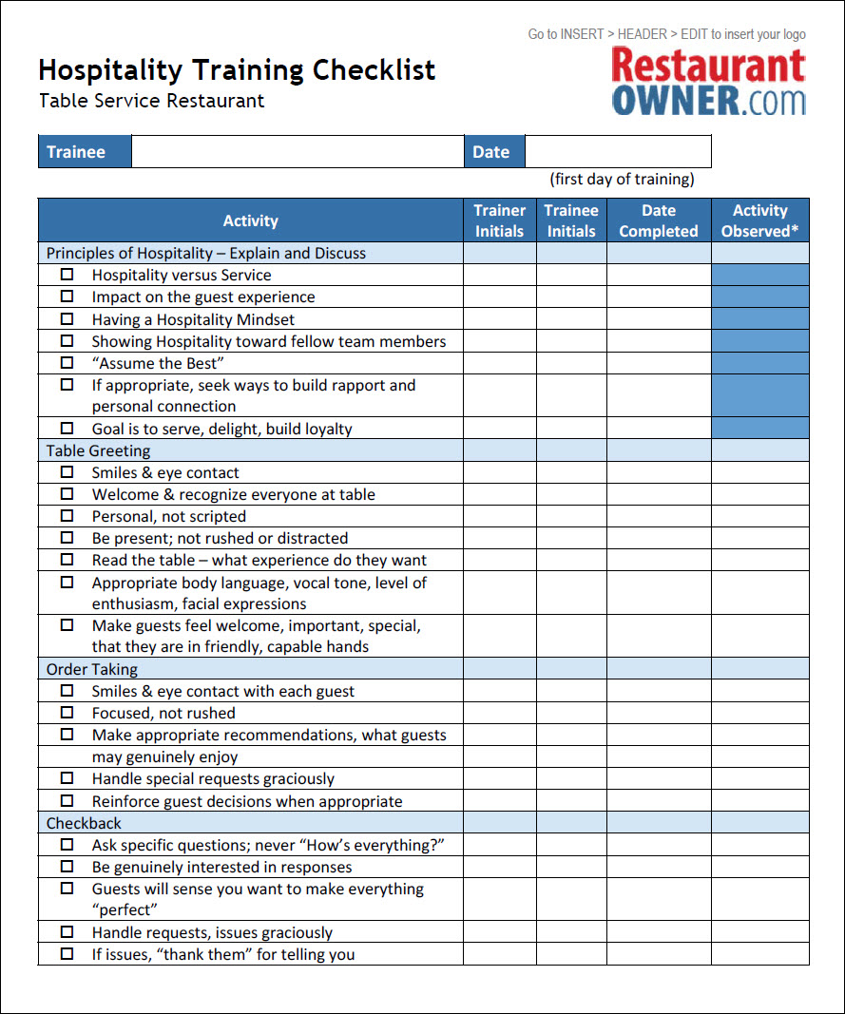
Observation List

Slide 10
Conclusion
Throughout the course of our project, we came to three general conclusions.
1. Food is a good lens for discussing the community economy. It provides a common ground for people to share their experiences, ideas, and frustrations, and to spark discussion and conversations about the current challenges in the conventional economic framework.
2. Popular education is a good tool for engaging people in their food economy. Participants in our workshop pilots learned a lot, illustrating the usefulness and importance of engaging different learning styles, as the “learning heads” metaphor explains in our popular education theoretical background section.
3. There is potential in this project to provide new information and to empower people to make the food system more just and sustainable. The Practical Visionaries Workshop team and Steering Committee members will continue this work into the Summer of 2013, and will make use of the recommendations and next steps detailed below.

Slide 11


